Slide 1

Predicting Diabetes with Machine Learning using data from a hospital in Frankfurt, Germany by benny frisella

Slide 2
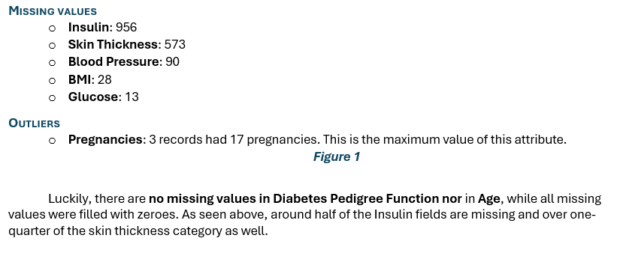
Data overview
9 columns,
Outcome is binary, diabetes diagnosis
2,001 observations, real, clinical data
~50% of insulin values were zero.
~27% of skin thickness were zero.

Slide 3
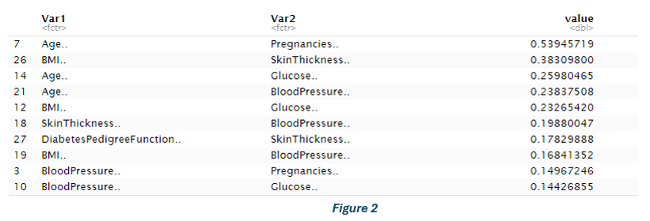
Data Cleaning & early analysis imputed mean for some, knn for others after standardization Standardization ensured fair comparisons; kNN imputation preserved relationships between features pairwise correlation matrix top 10 shows the highest correlations between numerical variables
As no pair exceeds 0.7, we ruled out multicollinearity as an issue and did not pursue dimensionality reduction immediately

Slide 4

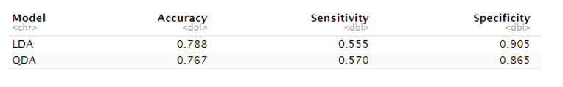
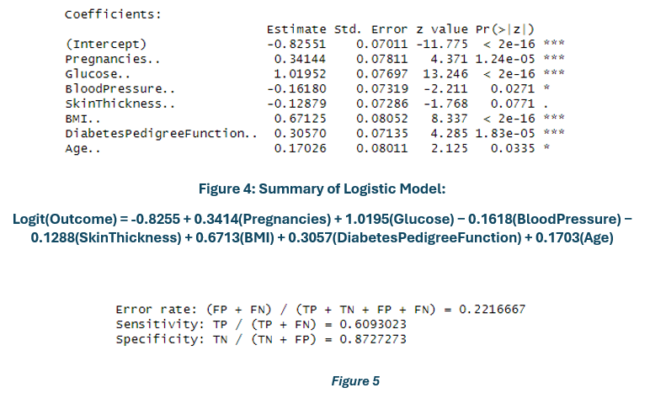
Linear Models & Baselines
Began with LDA and QDA, decent accuracy but low Sensitivity. A
Logic Regression improved accuracy but still struggled to catch Diabetes cases.
Despite tuning, these models plateaued at ~78% accuracy.

Slide 5
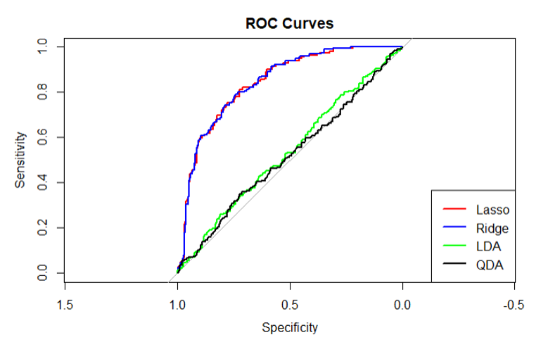
Regularization for Improvement
Lasso Regularization was the best performer
Ridge was almost identical to Lasso, suggesting multicollinearity was not a major problem.
Lasso showed slightly stronger sensitivity in the mid-range and high-specificity regions — likely due to its ability to regularize and shrink irrelevant coefficients.
LDA and QDA visibly underperformed across all thresholds — reinforcing that discriminative models are better suited here.
Lasso selected all variables – not one shrunk to zero.

Slide 6
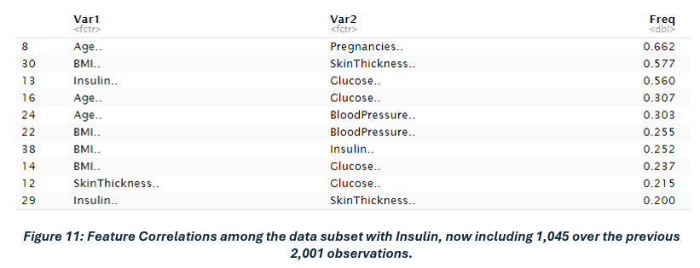
EDA Revisited & Feature Engineering
Higher correlations warranted Tree-based Analysis
Previous models left out insulin, brought it back but removed the rows afterwards.
Dataset still > 1,000 observations and with similar class proportions.

Slide 7
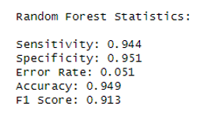
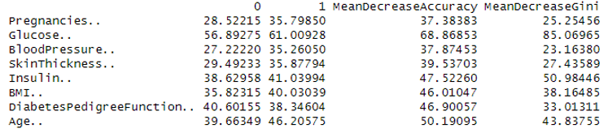
Random forest
Biggest leap in performance,
Accuracy jumped to 94.9%
Feature importance matched expectations:
glucose,
insulin,
age
were top predictors
←
←
←

Slide 8
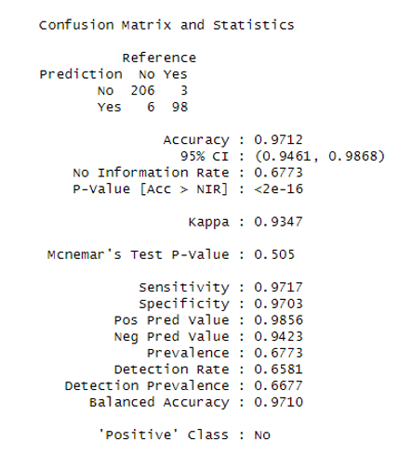
Tuned XGBoost: Best Model
Accuracy of 97.12%
Mcnemar’s P-Value shows no evidence of classification bias
Balanced, high Sensitivity & Specificity

Slide 9
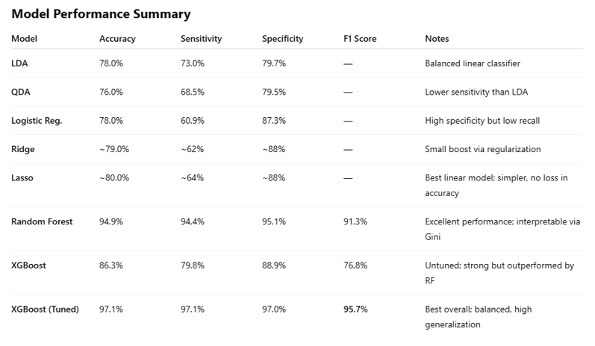
MODEL Comparison
Accuracies:
Linear models ➤ ~78%
Random Forest ➤ 94%
XGBoost ➤ 97%

Slide 10
Conclusion
The real lesson here: good modeling starts with good data.
Extensive EDA was essential to building quality models.

Slide 11
Future improvements
Practice makes perfect
Adding more features, like clinical variables, medical history, or lifestyle data.
Bigger, cleaner datasets.
Stacking multiple models or testing with neural nets may be worth exploring.
These directions could lead to better early diagnosis models and more personalized patient outcomes.

Slide 12
THANK YOU
Benny Frisella
Benny.frisella@utdallas.edu

